Slide 1
Performance-Based Funding
Presentation to IAL Workshop
June 2017
Joe Glover, university of florida

Slide 2
Every man has his own destiny: the only imperative is to follow it, to accept it, no matter where it leads him.
Henry Miller

Slide 3
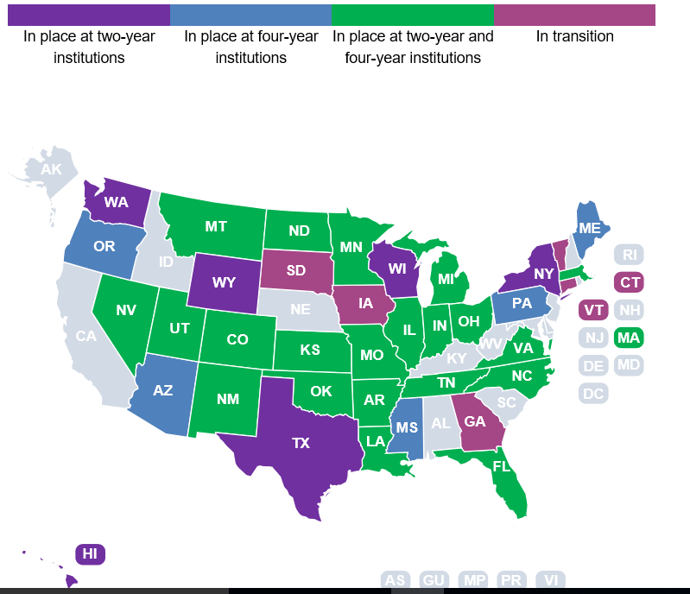

Slide 4
Thirty-two states—Arizona, Arkansas, Colorado, Florida, Illinois, Indiana, Kansas, Louisiana, Maine, Massachusetts, Michigan, Minnesota, Mississippi, Missouri, Montana, New Mexico, New York, Nevada, North Carolina, North Dakota, Ohio, Oklahoma, Oregon, Pennsylvania, South Dakota, Tennessee, Texas, Utah, Virginia, Washington, Wisconsin, and Wyoming—have a funding formula or policy in place to allocate a portion of funding based on performance indicators such as course completion, time to degree, transfer rates, the number of degrees awarded, or the number of low-income and minority graduates. Five states—Connecticut, Georgia, Iowa, South Dakota, and Vermont—are currently transitioning to some type of performance funding, meaning the Legislature or governing board has approved a performance funding program and the details are currently being worked out

Slide 5
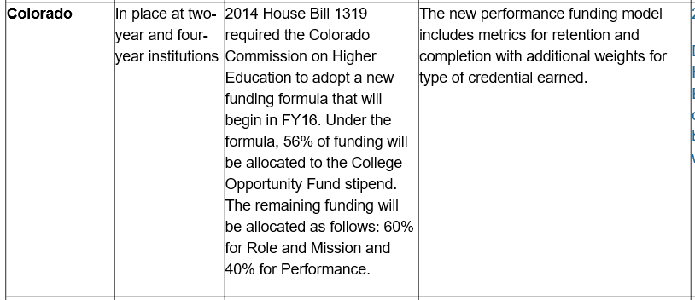
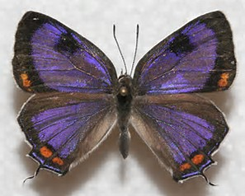

Slide 6
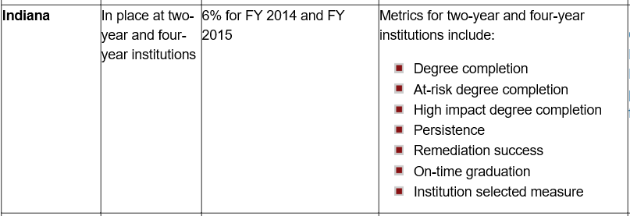
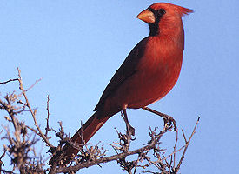

Slide 7
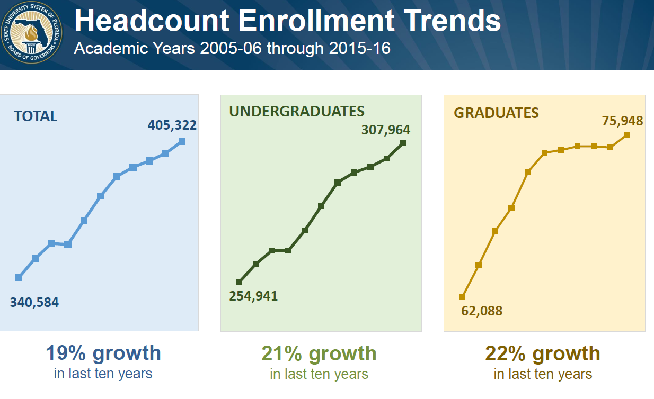

Slide 8
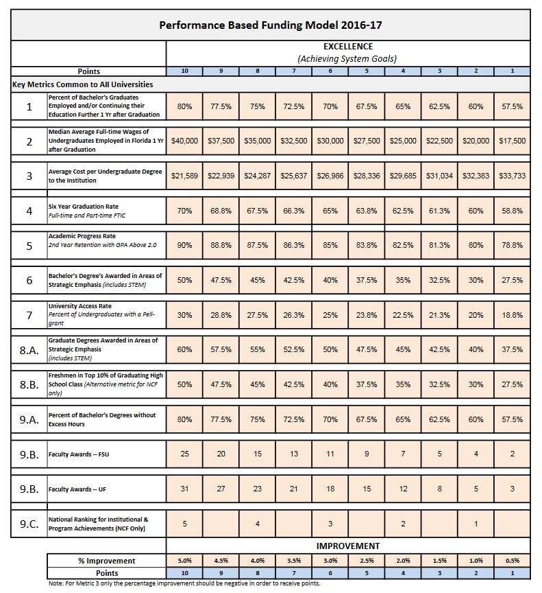

Slide 9
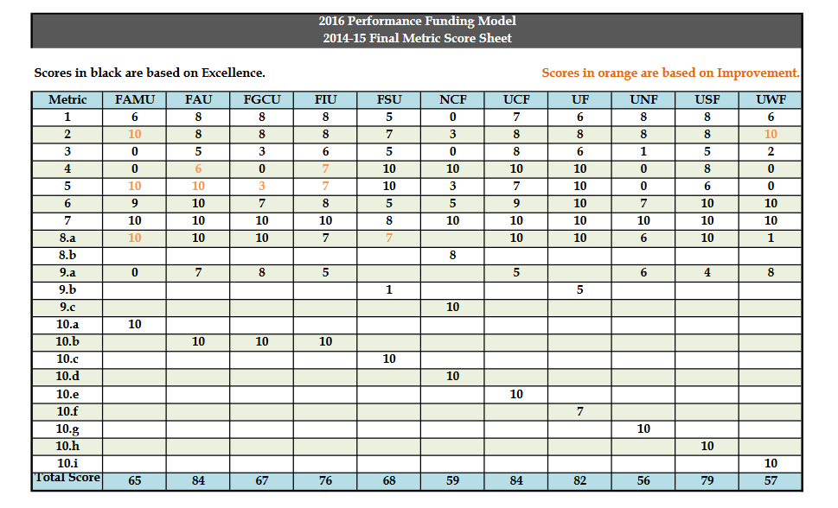

Slide 10
1. Percent of Bachelor’s Graduates Enrolled or Employed ($25K+) in U.S One Year After Graduation
This metric is based on the percentage of a graduating class of bachelor’s degree recipients who are enrolled or employed (earning at least $25,000) somewhere in the United States. Students who do not have valid social security numbers and are not found enrolled are excluded. Note: This data now non-Florida employment data.

Slide 11
2. Median Wages of Bachelor’s Graduates Employed Full-time in FL one year after graduation
This metric is based on annualized Unemployment Insurance (UI) wage data from the fourth fiscal quarter after graduation for bachelor’s recipients. UI wage data does not include individuals who are self-employed, employed out of state, employed by the military or federal government, those without a valid social security number, or making less than minimum wage.

Slide 12
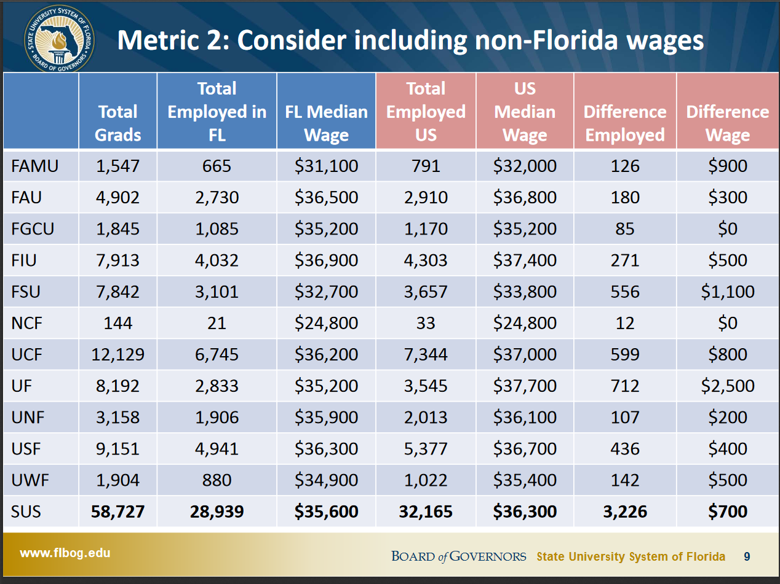

Slide 13
3. Cost per Bachelor’s Degree
Recently changed by BOG to mean cost to the student

Slide 15
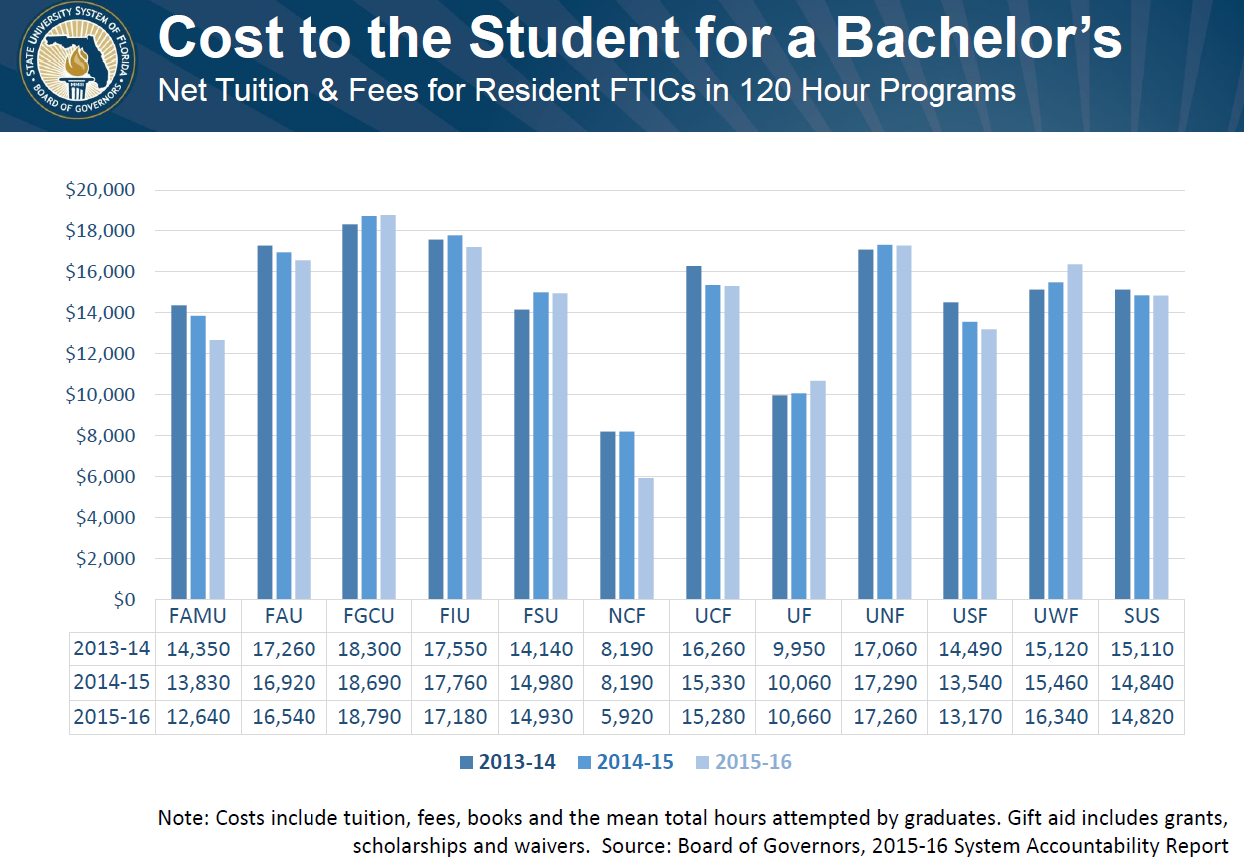

Slide 16
4. Six Year FTIC Graduation Rate
This metric is based on the percentage of first-time-in-college (FTIC) students who started in the Fall (or summer continuing to Fall) term and had graduated from the same institution within six years.

Slide 17
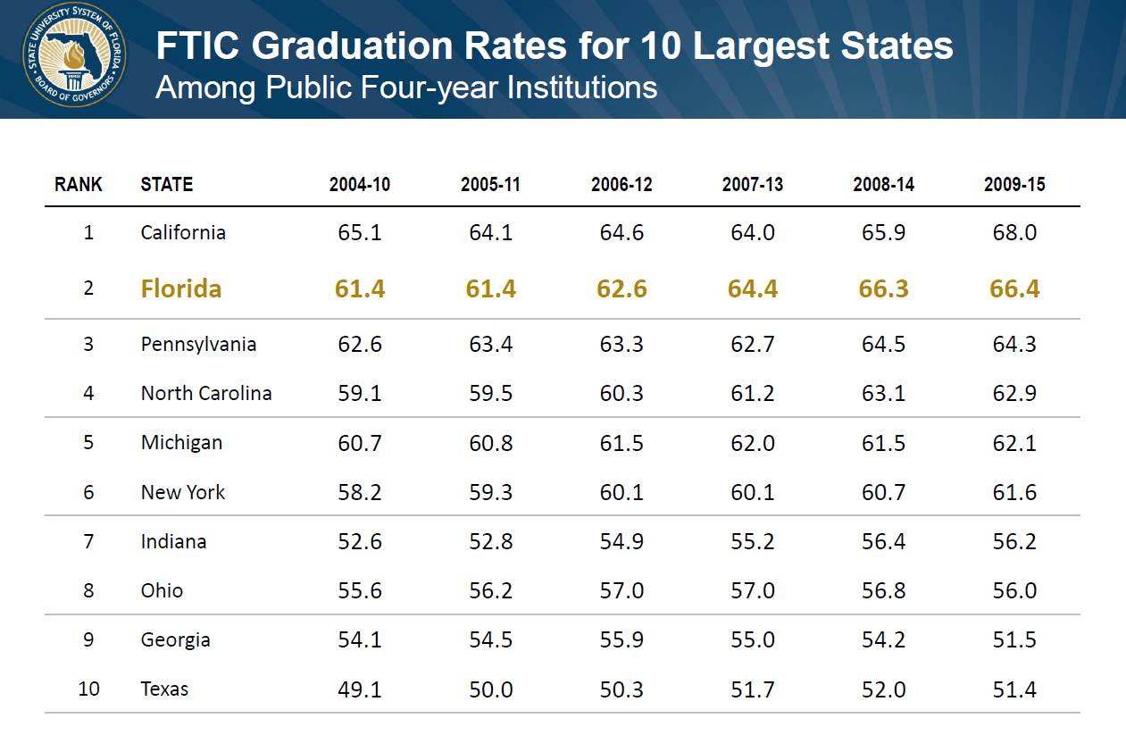

Slide 18
5. Academic Progress Rate
This metric is based on the percentage of first-time-in-college (FTIC) students who started in the Fall (or summer continuing to Fall) term and were enrolled full-time in their first semester and were still enrolled in the same institution during the Fall term following their first year with had a grade point average (GPA) of at least 2.0 at the end of their first year (Fall, Spring, Summer).

Slide 19
6. Bachelor’s Degrees within Programs of Strategic Emphasis
This metric is based on the number of baccalaureate degrees awarded within the programs designated by the Board of Governors as ‘Programs of Strategic Emphasis’. A student who has multiple majors in the subset of targeted Classification of Instruction Program codes will be counted twice (i.e., double-majors are included).

Slide 20
7. University Access Rate
This metric is based the number of undergraduates, enrolled during the fall term, who received a Pell-grant during the fall term. Unclassified students, who are not eligible for Pell-grants, were excluded from this metric

Slide 21
8. Graduate Degrees within Programs of Strategic Emphasis
This metric is based on the number of graduate degrees awarded within the programs designated by the Board of Governors as ‘Programs of Strategic Emphasis’. A student who has multiple majors in the subset of targeted Classification of Instruction Program codes will be counted twice (i.e., double-majors are included).

Slide 22
9. Number of Faculty Awards
Based on the number of faculty awards in the arts, humanities, science, engineering and health fields as reported in the annual ‘Top American Research Universities’ report. Twenty three of the most prominent awards are considered, including: Getty Scholars in Residence, Guggenheim Fellows, Howard Hughes Medical Institute Investigators, MacArthur Foundation Fellows, National Endowment for the Humanities (NEH) Fellows, National Medal of Science and National Medal of Technology, Robert Wood Johnson Policy Fellows, Sloan Research Fellows, Woodrow Wilson Fellows, to name a few awards. Source: Center for Measuring University Performance, Annual Report of the Top American Research Universities (TARU).

Slide 23
10. Licenses and Options
New metric 10 definition
UF has ranked in top ten nationally for years
In fiscal year 2015 (most recent data), UF ranked third in the nation for licenses and options executed(261) (behind the Minnesota system (268) and the University of Washington (337)).

Slide 24
1. Each Board of Trustees should choose three metrics from the attached list of metrics. One of the three metrics can be the current metric. If there is not a metric on this list that the university has included in its institutional strategic plan then contact Board staff to discuss. The three metrics should be prioritized in order of preference.
2. The Board of Trustees should propose benchmarks for excellence, on a scale of 1-10, for each of the three metrics. The excellence benchmarks should be established so that in the first year of implementation, the university will receive no more than seven (7) points.
3. The Board of Trustees should propose benchmarks for improvement, on a scale of 1-10, for each of the three metrics.

Slide 25
National Rankings for Universities
Freshman in Top 10% of Graduating High School Class
Professional Licensure & Certification Exam Pass Rates Above Benchmarks
Percent of SUS courses bearing a “high-quality” rating in the Florida Virtual Campus online catalog
Average Time to Degree
Four-Year Graduation Rates
Six-Year Graduation Rates
Percent of Bachelor’s Degrees without Excess Hours
Bachelor’s Degrees Awarded Annually
Graduate Degrees Awarded Annually

Slide 26
Bachelor’s Degrees Awarded to African-American & Hispanic Students
Number of Adult Undergraduates Enrolled
Percent of Undergraduate FTE in Online Courses
Number of Institutions with at least 30% of Fall Undergraduates Receiving a Pell Grant
Academic Progress Rate
Bachelor’s Degrees in Programs of Strategic Emphasis
Bachelor’s Degrees in STEM & Health
Graduate Degrees in Programs of Strategic Emphasis
Graduate Degrees in STEM & Health
Faculty Membership in National Academies

Slide 27
Faculty Awards
Percent of Undergraduate Seniors Assisting in Faculty Research or Percent of Undergraduates Engaged in Research
Total R&D Expenditures
Percent of R&D Expenditures funded from External Sources
Number of Patents Awarded Annually
Number of Licenses and Options Executed Annually
Number of Start-Up Companies Created
Number of Universities with the Carnegie Foundation’s Community Engagement Classification
Percentage of Baccalaureate Graduates Continuing Education or Employed

Slide 28
ALBERT EINSTEIN
“Many of the things you can count, don't count. Many of the things you can't count really count.”

